Slide 1
Data scientist vs software engineer
Tom Tran

Slide 2
Comparisons
Salary
Location
Coding languages and softwares
College degrees

Slide 3
Data
dataScience.csv and software.csv used to compare salary and location
dataScience.csv and indeedSoftware.csv used to compare coding languages/software and college degrees

Slide 4
Salary metrics
Entry Level: Less than 100k
Mid level: Between 100k-150k
Senior Level: Over 150K
The salaries were listed in a range, but I will use the average between the lower and higher salaries.

Slide 5
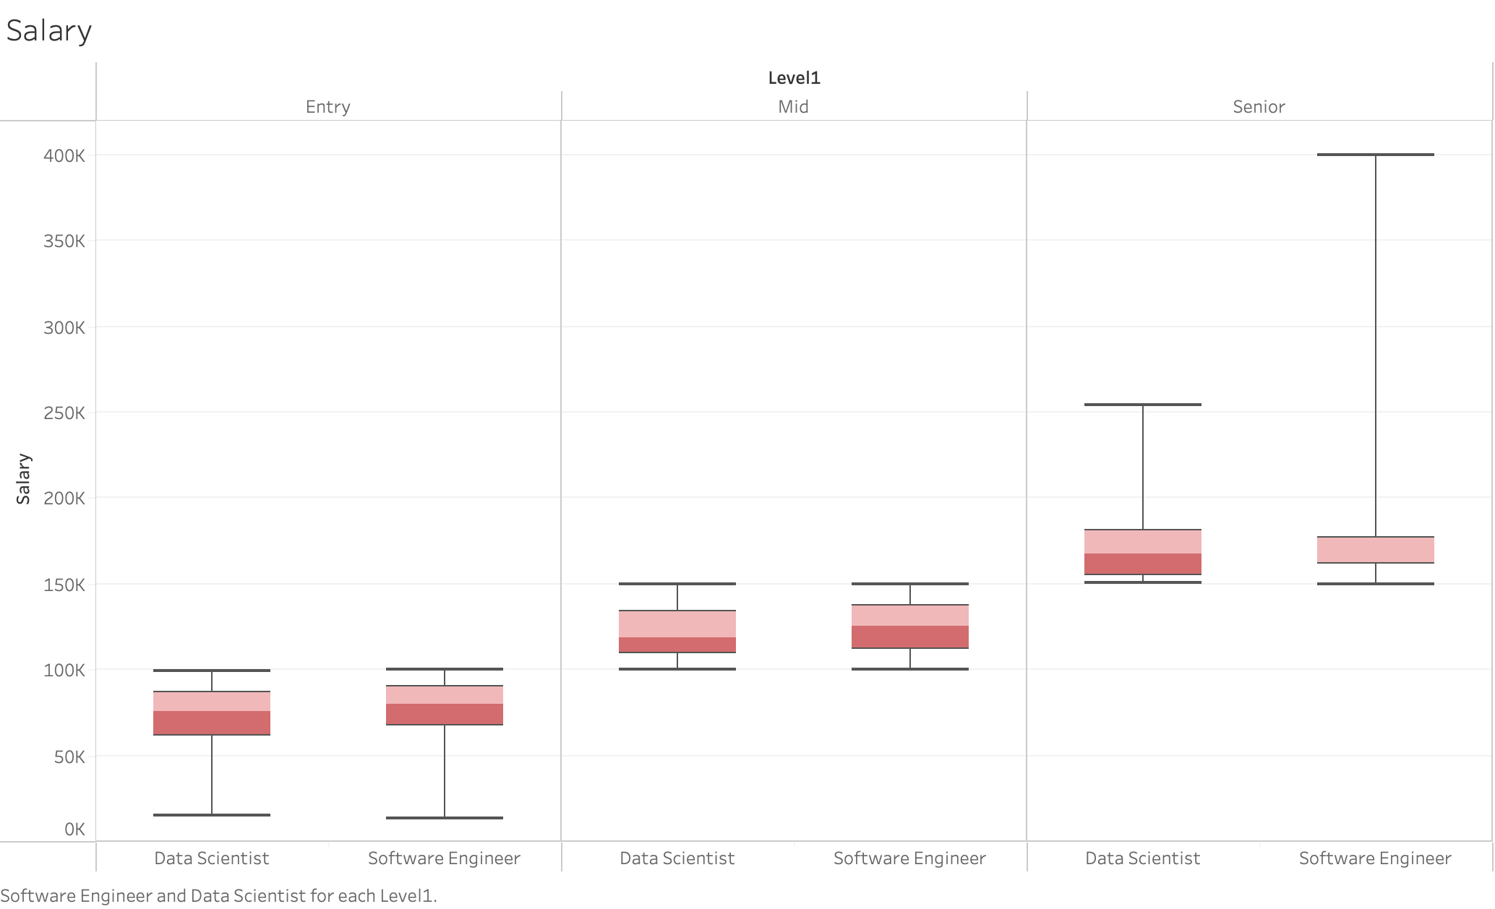
Salary

Slide 6
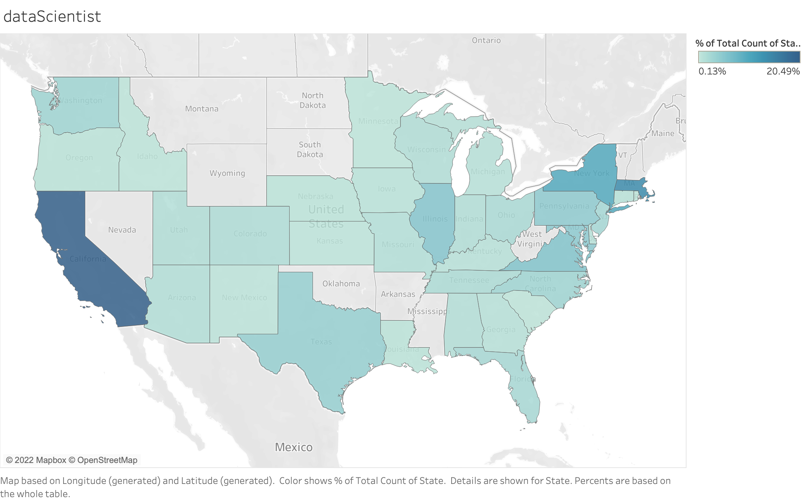
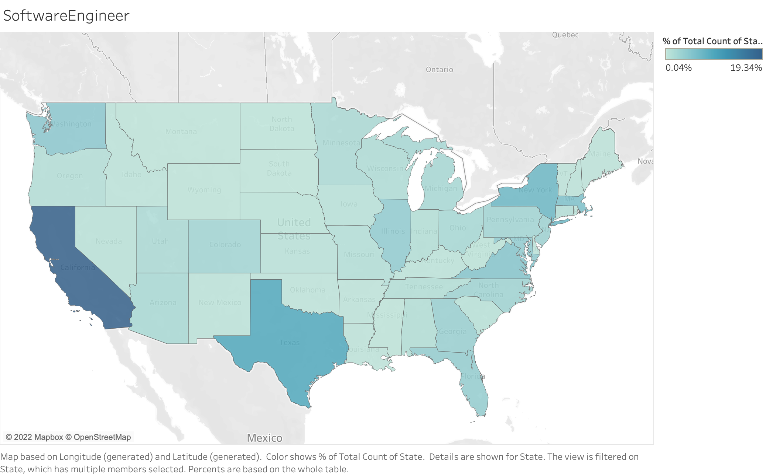
Location

Slide 7
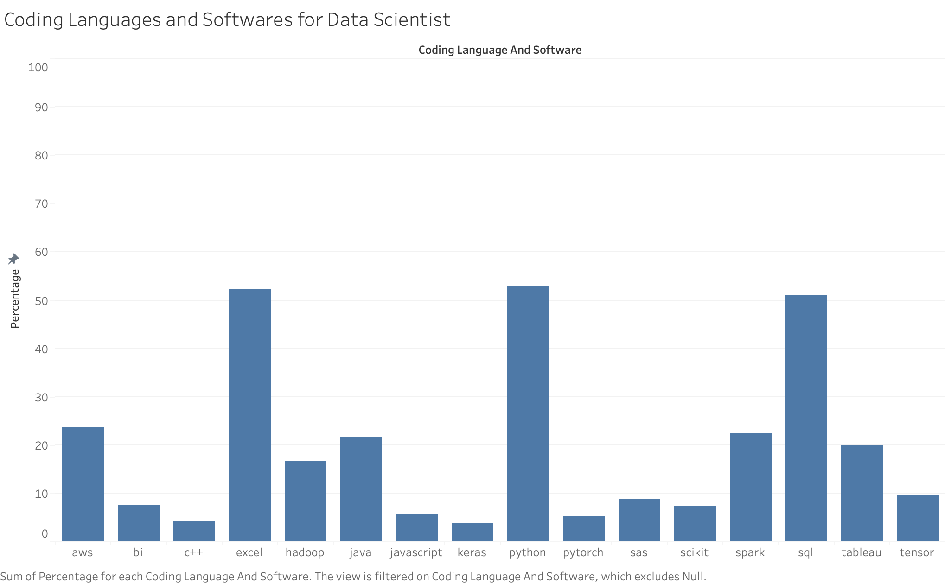
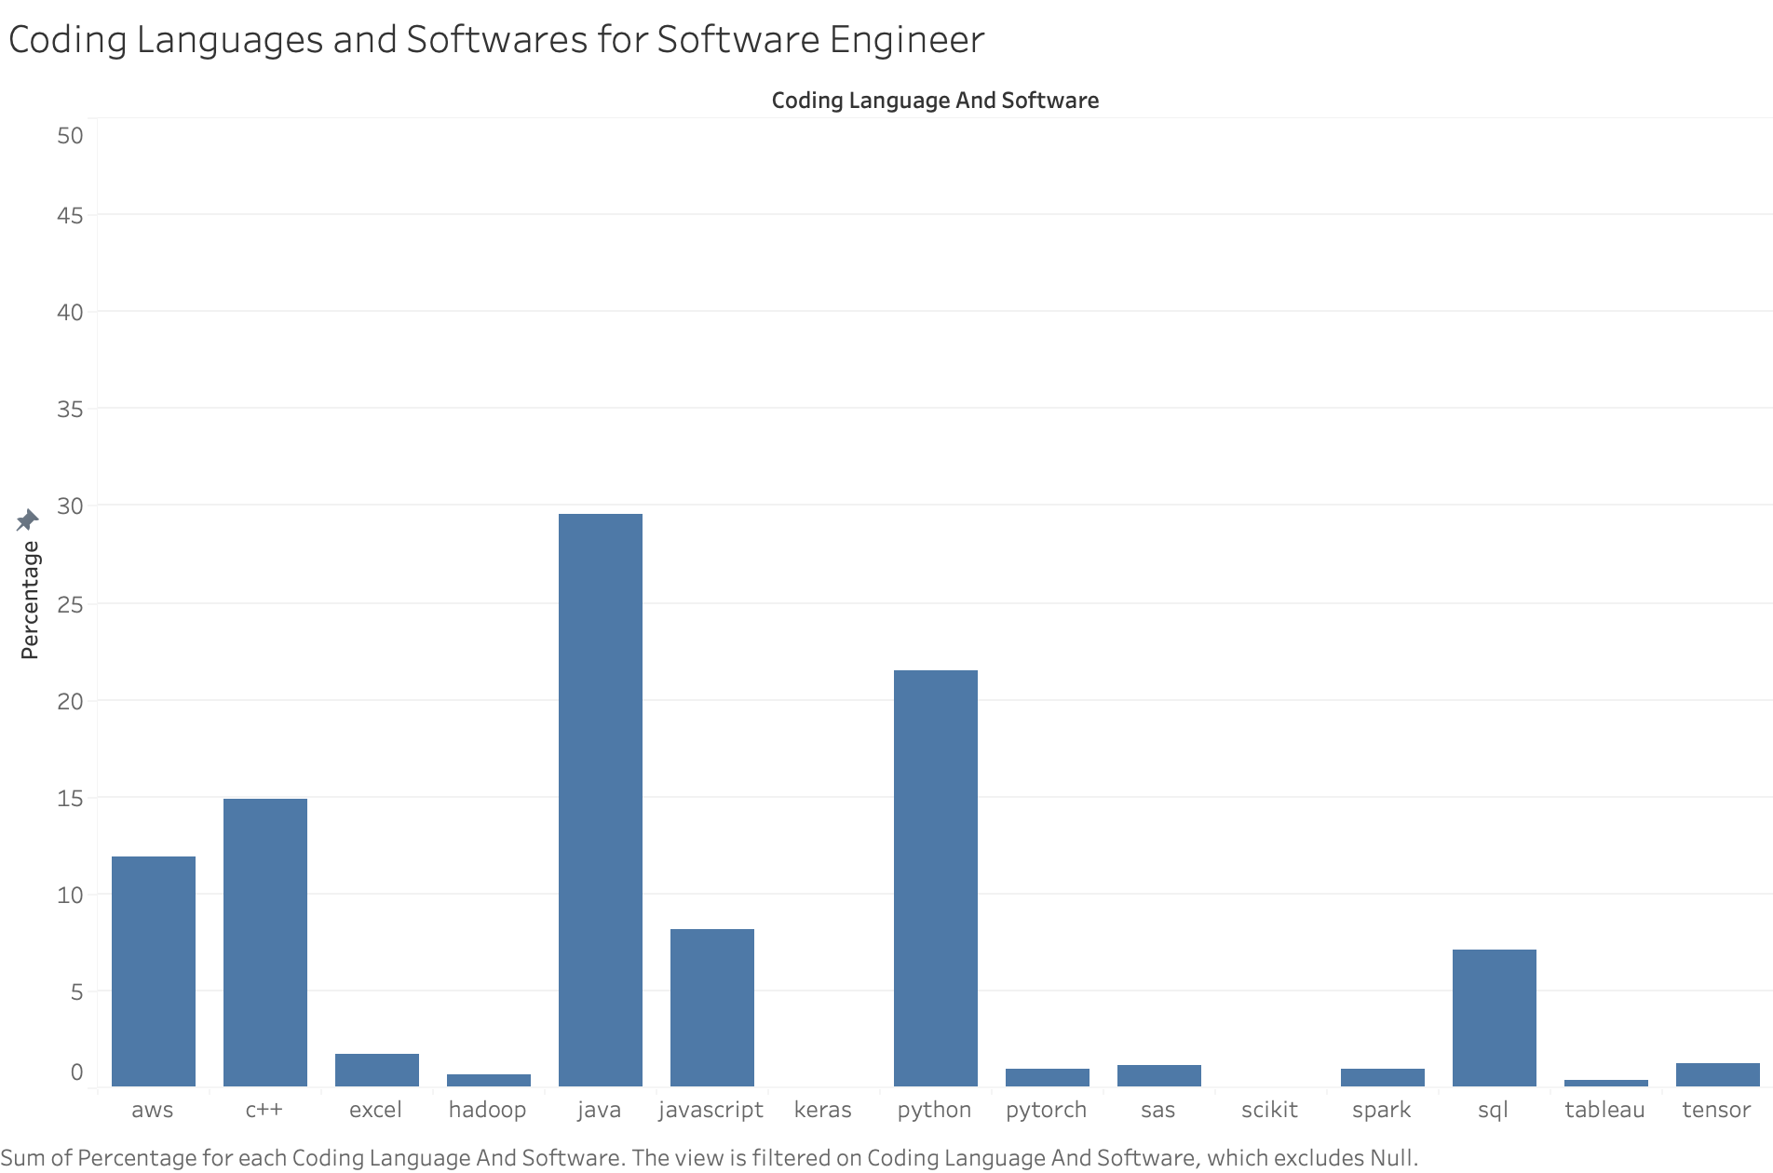
Coding languages and softwares

Slide 8
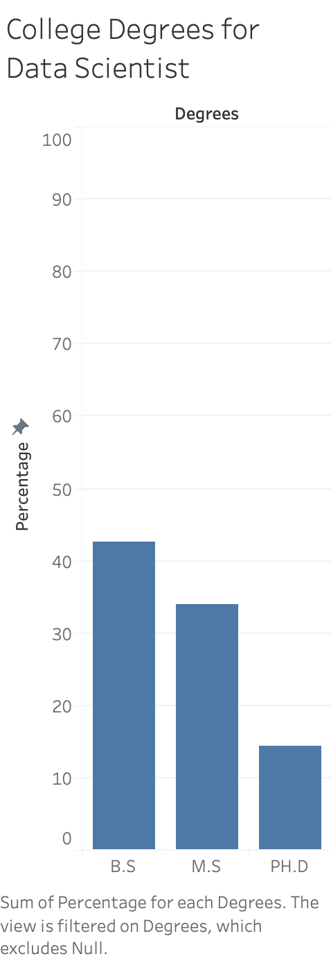
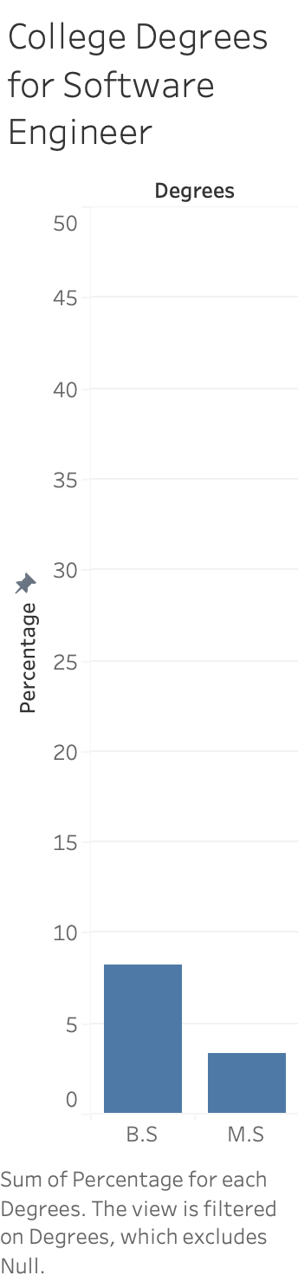
College degrees

Slide 9
conclusion
Salary: Don’t worry too much about the compensations for each levels. This all depends on your negotiation.
Location: Both careers are commonly known around the US. To maximize your career potential, I recommend looking into California, New York, and Massachusetts.
Coding Languages and Softwares: For data scientists, learn python, sql, and excel first. For software engineers, learn java, python, and c++. I recommend knowing java and python just in case you want to switch between these careers.
College degree: For data scientists, aim for bachelor’s degree and start looking for entry level position. Then go for master’s if you can. For software engineers, aim for bachelor’s degree. You could also do self study if you have the discipline.

